Slide 1

The Machine Learning Process
How do I rename columns
in a pandas DataFrame?
Reza Dibaj

Slide 2
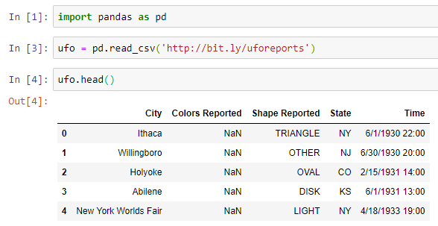
How to rename columns in pandas….
Let’s import ufo dataset again:
Notes:
import pandas as pd
ufo = pd.read_csv('http://bit.ly/uforeports’)
ufo.head()

Slide 3

Shortcut to check the columns name
A quick command to see the DataFrame’s columns:
Notes:
ufo.columns

Slide 4
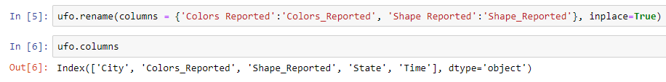
Let’s rename a few column names…
Imagine that we want to replace the space in ‘Colors Reported’ and ‘Shape Reported’ by underline.
The following method is the rename DataFrame method which passing a columns a dictionary as follows:
Key
Value
Key
Value
Checking the result
To impact on the current DataFrame
Notes:
ufo.rename(columns = {'Colors Reported':'Colors_Reported', 'Shape Reported':'Shape_Reported'}, inplace=True) ufo.columns

Slide 5
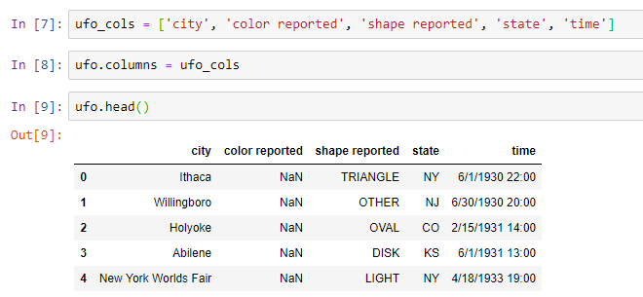
Another column renaming method
What if we want to change all the column names and do not want to use key-value or old name-new name form format?
The following is one of the possibilities….
Changing all the columns to the lower case
Replacing the current with the defined collection
Result
Notes:
ufo_cols = ['city', 'color reported', 'shape reported', 'state', 'time’]
ufo.columns = ufo_cols
ufo.head()

Slide 6
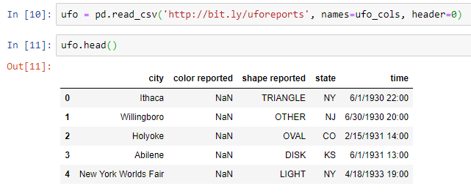
Renaming columns while reading a dataset
We can assign the column names while we are reading the source file, as follows:
header=0 means that the first row of the dataset, which is indexed by zero, has existing column names and I replaced them with the defined collection.
Replace the column names with the defined collection
Notes:
ufo = pd.read_csv('http://bit.ly/uforeports', names=ufo_cols, header=0)
ufo.head()

Slide 7

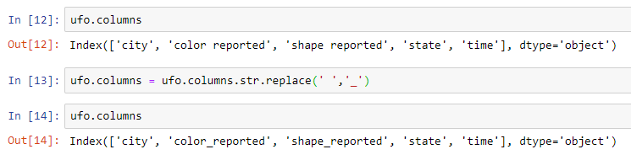
Bonus Tip
Imagine if we have a dataset that contains 100 columns and some of these columns contain space(s) in their names.
In this case, we can use the string library, str, and the replace method inside the str library to replace all spaces with underscores as follows:
Notes:
ufo.columns
ufo.columns = ufo.columns.str.replace(' ','_')
ufo.columns

Slide 8

Thank you
Question?
To be
Not to be

